Slide 1
Digital accessibility basics
…and then some

Slide 2
“Good accessibility is a measurable collaboration between content, design, and technology through consistent, repeatable processes.”
- Oskar Westin (that’s me)
Notes:
“Good accessibility is
a measurable collaboration between
content, design, and technology
through consistent, repeatable processes.”

Slide 3

Oskar Westin
Digital content manager
Accessibility advocate
Author of fiction
@oskarwestinTO
Find me on LinkedIn: linkedin.com/in/oskarwestin/
Notes:
Oskar Westin
Digital content manager
Accessibility advocate
Author of fiction
@oskarwestinTO
Find me on LinkedIn https://www.linkedin.com/in/oskarwestin/

Slide 4

What is Digital Accessibility?
Image credit: Open Access Government
Notes:
What is Digital Accessibility?
Next slide
Image credit: Open Access Government
https://www.openaccessgovernment.org/digital-accessibility-public-sector-wcag-3-0/113059/

Slide 5
Digital accessibility (A11y)
Digital accessibility (a11y) provides equitable access to people who need assistive technology to access our digital content, products and services.
A11y is a Numeronym for accessibility. It’s the eleven letters between the A and the Y in Accessibility.
Notes:
Digital accessibility (A11y)
Digital accessibility (a11y) provides equitable access to people who need assistive technology to access our digital content, products and services.
A11y is a Numeronym for accessibility. It’s the eleven letters between the A and the Y in Accessibility.

Slide 6
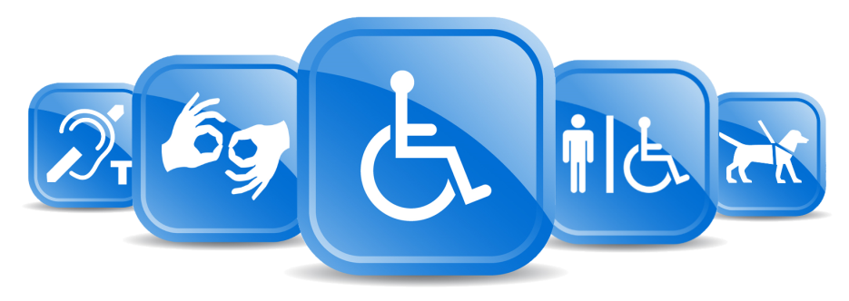
What is disability?
Disability is a mismatch between a person’s abilities and their environment
Image credit: Developmental Services of Leeds and Grenville
Notes:
What is disability?
Disability is a mismatch
between a person’s abilities
and their environment
Image credit: Developmental Services of Leeds and Grenville

Slide 7
what is WCAG
The web content accessibility guidelines (WCAG) are a resource to help you build inclusive content.
Many legislative bodies refer to WCAG 2.x
Conforming to WCAG does not guarantee that your website is accessible
This is not the only reference you need to consider.
Notes:
So, what is WCAG and what is it for?
The web content accessibility guidelines (WCAG) are a resource to help you build more inclusive content.
Many legislative bodies refer to WCAG 2.x
Conforming to WCAG does not guarantee that your website is accessible
This is not the only reference you need to consider.

Slide 8
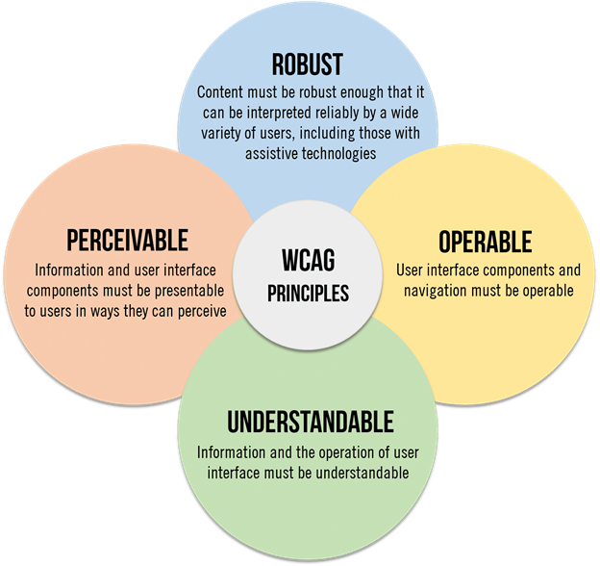
WCAG Principles and Guidelines
Perceivable
Operable
Understandable
Robust
Notes:
WCAG Principles and Guidelines
Current versions of WCAG are grouped into four categories
Perceivable
Information and user interface components must be presentable to users in ways they can perceive
Operable
User interface components and navigation must be operable
Understandable
Information and the operation of the user interface must be understandable
Robust
Content must be robust enough that it can be interpreted reliably by a wide variety of users, including those with assistive technologies
There is often overlap and similar success criteria

Slide 9



Principle 1: Perceivable
Information and user interface components must be presentable to users in ways they can perceive
This means that users must be able to perceive the information being presented (it can't be invisible to all of their senses)

Slide 10

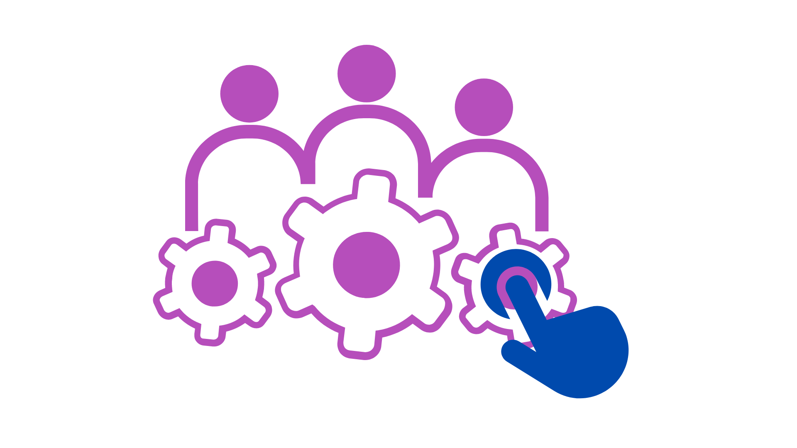
Principle 2: Operable
User interface components and navigation must be operable.
This means that users must be able to operate the interface (the interface cannot require interaction that a user cannot perform)

Slide 11

Principle 3: Understandable
Information and the operation of user interface must be understandable.
This means that users must be able to understand the information as well as the operation of the user interface (the content or operation cannot be beyond their understanding)

Slide 12

Principle 4: Robust
Content must be robust enough that it can be interpreted reliably by various user agents, including assistive technologies.
This means that users must be able to access the content as technologies advance (as technologies and user agents evolve, the content should remain accessible)

Slide 13
Does wcag help people?
WCAG provides success criteria and guidelines to help create a more inclusive experience for people
WCAG can also be a barrier leading to a false sense of success
Who are the people we’re designing for?
Notes:
So, Does WCAG help people?
WCAG can help you and your users
WCAG provides success criteria and guidelines to help create a more inclusive experience
WCAG can also become a barrier
Treating WCAG as a guide rather than a source of truth is helpful.
Who are the people we’re design for?
Understanding who our users are is fundamental for accessibility

Slide 14
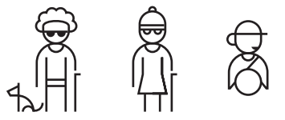
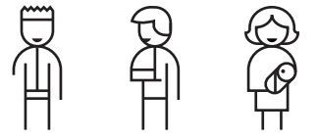
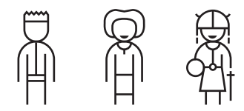

Inclusive Design
PERMANENT
TEMPORARY
SITUATIONAL
PERMANENT
TEMPORARY
SITUATIONAL
See
Touch
Blind
Cataract
Distracted Driver
One Arm
Arm Injury
New Parent
Speak
Hear
Non-Verbal
Laryngitis
Heavy Accent
Deaf
Ear Infection
Bartender
Think*
*The Cognitive category (Think) was added by me
Microsoft Inclusive Design
ADHD
Blood Clot
Stress
Notes:
Microsoft's Inclusive Design Tool kit provides examples of
Permanent, Temporary, and Situational disabilities
in four plus one categories:
See, Touch, Speak, Hear, and an added category called Think.

Slide 15



Accessible User Personas and Experiences
Content
Design
Technology
Practice | Persona | Experience
Content | Content order (keyboard) | dexterity, cognitive, blind/low-vision
Content, design | Magnification/text resize | low-vision, cognitive
Design, content | Colour contrast | low-vision, cognitive
Design, technology | Contrast themes | low-vision, cognitive
Design, technology | Time-based (reduced motion and text) | low-vision, cognitive
Content, technology | Screen reader | blind/low-vision, cognitive/ language barriers
Notes:
Another way to consider people with disabilities is through personas.
What are the tools that people with disabilities might use to adapt their experiences to the web?
How can we as content writers, designers, or developers address these items to build a more inclusive experience?

Slide 16

Functional Accessibility requirements (FARs)
Where visual modes of presentation are provided | Where auditory modes of presentation are provided | Where speech is required to operate a function
Where manual dexterity is required for operation | Where hand strength is required for operation | Where operation requires reach
Where memorization is required for use | Where text literacy is required for use | Where extended attention is required for use
Where operation has time limits | Where controlled focus is required for use | Where specific sequencing of steps for operation is required
Where abstract thinking is required | Where accuracy of input is required | Where biometrics are employed
Functional Accessibility Requirements: an online toolkit
Notes:
Functional Accessibility Requirements (FARs) proposed a way to consider user experiences.
These requirements are defined by an experience,
“When visual modes are provided”
and an outcome,
“at least one configuration must be provided that does not require vision,”

Slide 17
Functional cognitive needs
Functional Needs | Examples of related experience
Attention | Attention Deficit (Hyperactivity) Disorder (ADD/ADHD)
Language & literacy | Aphasia, Dyslexia, Visual Processing Disorders
Learning | ADHD, Autism, Brain Injury, Dyscalculia
Memory | Mild Cognitive Impairments, Brain Injury, Depression, PTSD
Executive function | Brain Injury, Autism, Aging, Environmental Factors
Notes:
This example identifies functional needs and accessible user experiences that may be impacted by the requirement
For example, a task that requires attention might present a barrier to people with ADHD

Slide 18
What about WCAG
WCAG is still a good resource
Target the latest recommendations WCAG 2.0
Be ready to adapt changes to WCAG by adopting user-based perspectives
Notes:
What about WCAG
WCAG is still a good resource
Target the latest recommendations WCAG 2.0
Be ready to adapt changes to WCAG by adopting user-based perspectives

Slide 19
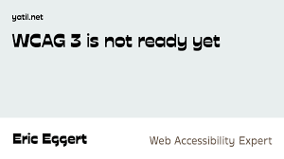
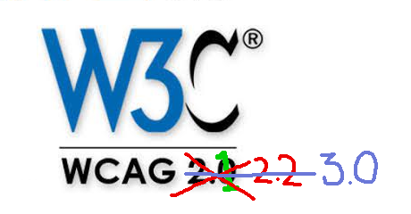

WCAG 3.0 …
WCAG 3.0 will address
a wider range of users
a wider range of technologies
approaches to testing and conformance
WCAG 3.0 is not ready
User-centred design will help to anticipate the future of accessibility
Notes:
WCAG 3.0 will
The next version of WCAG will
address a wider range of users
a wider range of technologies
support new approaches to testing and conformance
WCAG 3.0 is not ready
Understand a user-centred design approach to anticipate the future of accessibility

Slide 20
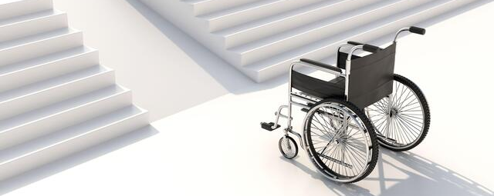
A reminder: What is disability?
Disability is a mismatch between a person’s abilities and their environment
Notes:
What is disability?
Disability is a mismatch
between a person’s abilities
and their environment
Image credit: Developmental Services of Leeds and Grenville

Slide 21




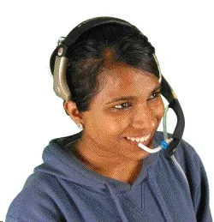
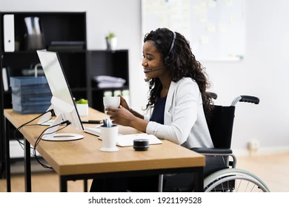
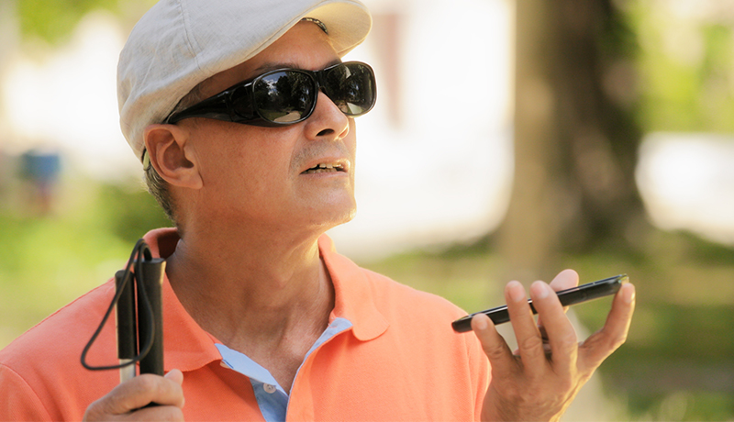

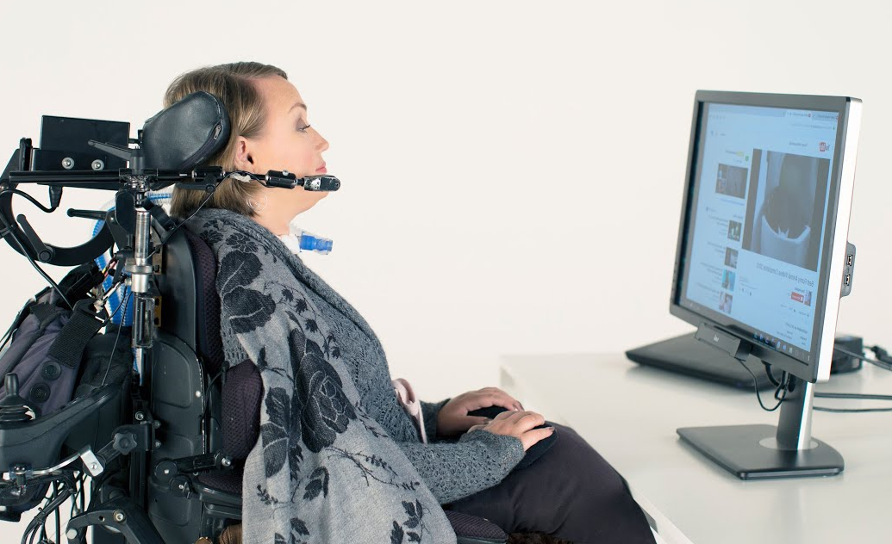
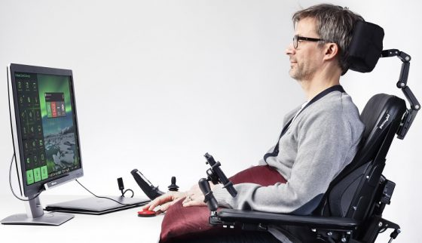
Digital accessibility
The basics of accessibility are people-driven
And not rooted in requirements or conformance
Understand the experiences you are building for
And don’t create barriers to your content or products
Notes:
The basics of accessibility are people-driven
And not rooted in requirements or conformance
Understand the experiences you are building for
And don’t create barriers to your content or products

Slide 22
Thank you
Discussion …
oskarwestin.com/accessibility/

